Slide 1
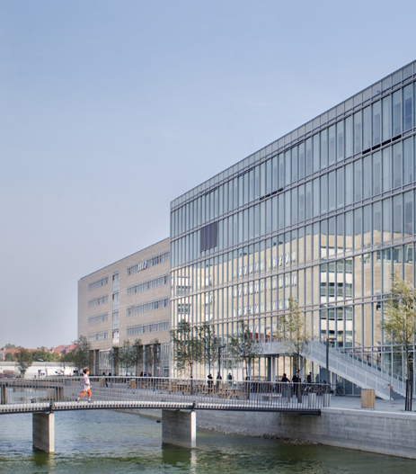
Tracing the Indo-Europeans: their language and culture
Birgit Anette Rasmussen (Olsen)
Roots of Europe, language, culture, and migrations
Department of Nordic Studies and Linguistics

Slide 2
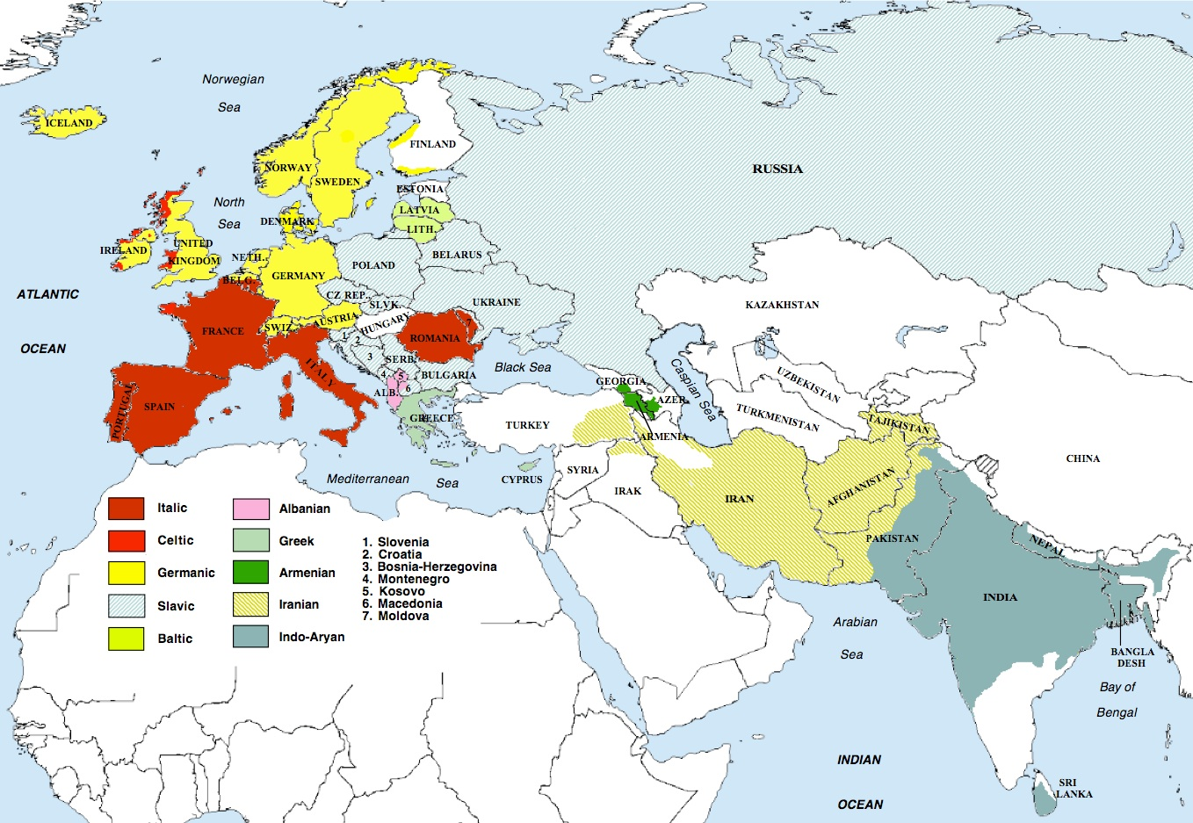
The Indo-European language family

Slide 3
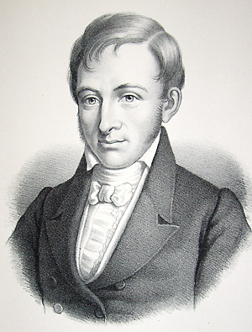
The roots of Indo-European studies
Rasmus Rask (1787 - 1837):
Investigation of the origin of the Old Norse or Icelandic language (1814; printed 1818)
The Germanic soundshift =
Grimms lov (Rask-Grimms lov):
Latin : English
pater : father
tenuis : thin
cornu : horn

Slide 4

Jacob Grimm (1785-1863; Deutsche Grammatik 1816)

Slide 5
Other words with *p-
Sanskrit Greek Latin English
pād- pod- ped- foot
piscis fish
pard- perd- fart
pūr fire
prthu- platus flat
plav- ple(u)- flow
pōlos foal
priya- friend
paśu- pecu fee

Slide 6
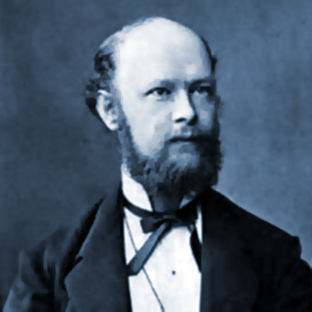
Karl Verner (1846 - 1896) and the Neogrammarians
Neogrammarian credo:
Sound laws are exceptionless
Verner:
”No exceptions without a rule”
Sound change is often conditioned
Gothic German Sanskrit
broþar Bruder bhrā́tar-
fadar Vater pitár-
Eine Ausnahme der ersten Laut-
verschiebung (1876)

Slide 7
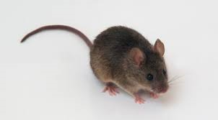
Example: the mouse
Dan. mus (hus) OCS myšŭ (you: ty) Lat. mūs
Eng. mouse (house) Russ. myš’ Gk. mūs
Germ. Maus (Haus) Pers. mūs
Dutch muis (huis) Skt. mūṣ- Arm. mukn
Alb. mi (you: ti)
Reconstruction: Proto-Indo-European *mūs (or *muhs)

Slide 8
What can we reconstruct?
  Phonology (”sounds”) : e.g Germanic and PIE *-ū-, as in the word for ‘mouse’
  Morphology (”grammar”): e.g. Germanic genitive ending in *-s(-)
- Whole words, e.g. Germanic ‘mouse’
- Syntax/whole phrases: rarely and more difficult

Slide 9
What is palaeolinguistics?
If a given word or phrase can be reconstructed on the basis of several – preferably geographically distant - branches of the Indo-European family with regular sound change and (reasonably) identical meaning, the corresponding concept belongs to the common, inherited culture.
Beware of Loanwords
Independent formations
Attestation only in neighbouring branches
So: the Indo-Europeans knew of mice, and they had fathers and brothers.
But what can the common vocabulary tell us about their culture?

Slide 10
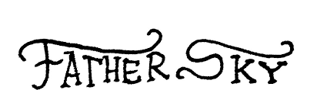
Set phrases
  Sanskrit Dyaus pitā
  Greek Zeũ páter (vocative)
  Latin Iuppiter
  PIE *di̯ḗu̯s pə2tḗr

Slide 11
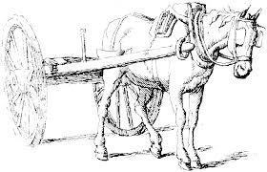
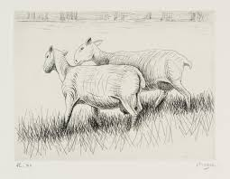


August Schleicher’s Indo-European fable (1868)
Avis, jasmin varna na ā ast, dadarka akvams …
”a sheep on which there was no wool, saw (some) horses, one pulling a heavy wagon, another one a great load …”
sheep – wool – horse – wagon
p

Slide 12
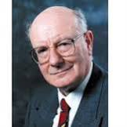
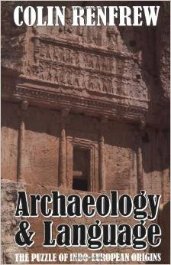
The Anatolian hypothesis
Archaology and Language – the Puzzle of
Indo-European Origins (1987)
  Homeland: Anatolia, about 7000 BC
  The Indo-Europeans brought agriculture to
  Europe, slowly and peacefully
  (2 km. a generation; the ”wave of advance”-
  model)

Slide 13
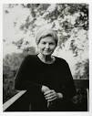
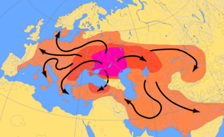
The Pontic-Caspian (”kurgan”) hypothesis
Marija Gimbutas (1921-94).
Indo-European homeland on the South
Russian and Ukrainian steppes north of the Pontic and Caspian Sea; migration about 4500-2500 BC

Slide 14
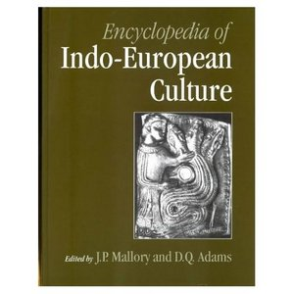
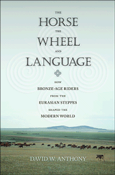
The Pontic-Caspian hyptothesis
J.P. Mallory & D.Q. Adams: Encyclopedia of Indo-European Culture (1997)
David Anthony: The Horse, the Wheel and Language (2007)
The Yamnaya Culture

Slide 15
How did they get around? horse and wheel
  *(h1)ek’u̯os ‘horse’: Sanskrit áśva-, Avestan aspa-, Greek híppos (Myc. i-qo), Latin equus, Old Irish ech, Old English eoh, Tocharian yakwe etc.; Hier. Luwian á- sù-, Lycian esb- ‘horse’
  Names: Sanskrit Brhadasva- ‘High-horse’, Greek Xanthippos ‘Golden-horse’
    Domestication 4800-4500 BC
    *k^{w}ek^{w}lo- ‘wheel’: Sanskrit cakrá-, Avestan caxra-, Greek kúklos, Old English hweol, Tocharian A kukäl
    Pre-IE: *k^{w}e-k^{w}lh₁o- ‘roll-roll’
    Old Irish roth, Old High German rad, Lithuanian rãtas, Latin rota ‘wheel’; Sanskrit rátha-, Avestan raθa- ‘chariot’; root *ret- (or *ret^{h}-) ‘run’

Slide 16
Wheeled vehicles
  *h2ak’s- ‘axle’: Sanskrit ákṣa-, Greek axōn (Myc. a-ko-so-ne), Latin axis, Old High German ahsa, Lithuanian ašìs, Old Slavic osь; Welsh echel, Old Norse ǫxull
  *h2/3eihos-/*h2/3ihs- ‘shaft’: Hittite hissas ‘pole, shaft’, Sanskrit īșā-, Slovene oje (plur. ojesa) ‘pole, shaft’
  *u̯eg’he-: ‘convey (in a wagon)’: Sanskrit váhati, Avestan vazaiti, Greek (Pamphylian) wekheto, Latin vehit, Old Norse vega, Lithuanian vežù, Old Slavic vezǫ; Albania vjedh ‘steals’; Cf. also Sanskrit vahitram, Latin vehiculum ‘wagon’ (English way)
  *iugóm: ‘yoke’: Ved. yugám, Gk. zugón, Lat. iugum, OWelsh iou, English yoke; Hitt. iūk- ‘yoke, pair’< *ieug-; root *ieug- ‘connect, pair’
  Wheel and wagon after 4000-3500 BC. Must belong to ”core Indo-European”, according to Renfrew (Gray-Atkinson, Bouckaert) no later than 6500 BC.

Slide 17
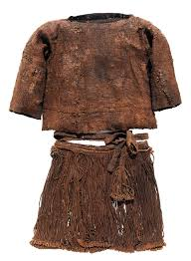
How did they dress?

Slide 18
The word for ‘wool’
PIE *h₂ul̥h₁-nah₂:
Ved. rṇā-, Av. varənā-, Lat. lāna,Welsh gwlan, English wool, Lith. vìlna, OCS vlnъa
Gk. lẽnos (n) (for expected lēnē, f.) probably modelled after eĩros, pókos ‘wool’
Hitt. hulana- ‘wool’ < *h₂ulə₁-nah₂ or *h₂ulh₁-n̥nah₂
Common IE protoform secured, but what exactly did *h₂ul̥h₁-nah₂ mean? Root *h₂uelh₁- ‘pluck’ as in Latin vello ‘pluck’ and vellus ‘fleece’

Slide 19
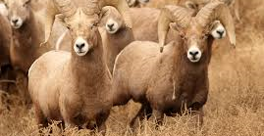

Wild and domesticated sheep
Sheep are domesticated from about 8000-7500 BC (Anatolia), but their ”wool” is ”structually unspinnable” (Elizabeth Barber). They shed their coats annually, and the shedding may be used for felt.
Wool sheep mutation perhaps about 4000-3500 BC.

Slide 20
Textile production
*(h₁)u̯eb^{h}- (or *(h₁)uebh₁-): Hitt. wep- ‘weave’, wepa- ‘woven fabric’, Toch.B. wāp- ‘weave’, skr. ubhnāti ‘bind’, Av. vaf- ’praise’ (!), but also adj. ubdaēna- ‘of woven fabric’, Gk. hupháinō ‘weave’, Myc. fut.ptc. e-we-pe-se-so-me-na, Alb. vej,
English weave
*spenh₁- ’stretch; spin’: Tokh.A. pānw- ’stretch out’, Gk. pénomai ’work’, Arm. hanum, henum ‘weave’, English spin, Lith. pinú ’plait’

Slide 21
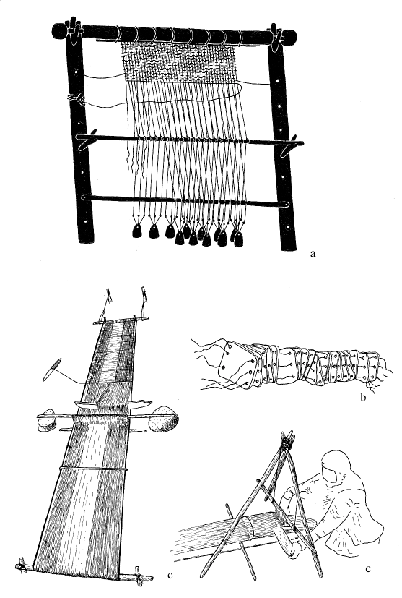
The loom

Slide 22
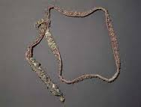
The garments – the gird, belt
*ieh3s-: Lith. júosiu ‘gird, girdle’, Gk. zoma ‘best’, Av. yasto ‘belt’ etc.

Slide 23
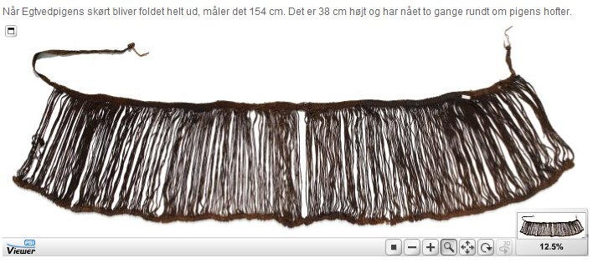
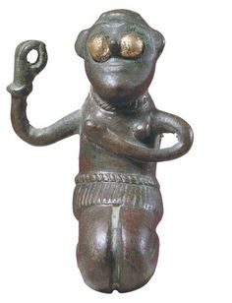
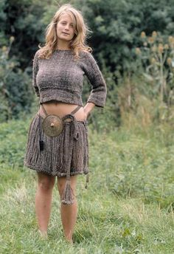
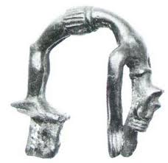
The string skirt

Slide 24

The string skirt
String skirts also found with ”Tocharian” mummies
Similar traditions in the Balkans, and cf. Iliad 14:
Hera tries to seduce Zeus wearing ”a girdle crafted with a thousand tassels”

Slide 25
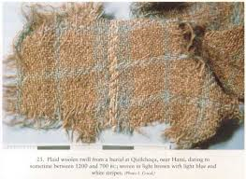
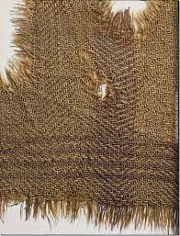
Ancient woolen textiles
Ürümchi, Xinjiang, China Hallstatt, Austria

Slide 26
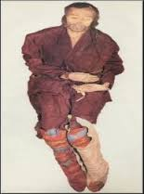
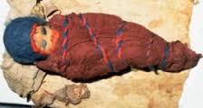
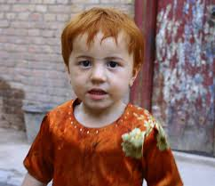
Ürümchi mummies (Elizabeth Barber 1999)

Slide 27
What were their families like?
The wife’s words (to take a wife = to conduct, Engl. wed, wedding)
Husband’s brother
*daiuér-: Skt. devár-, Pashto levar, Gk. daēr, Arm. taygr, OCS děverъ,OE tācor, OHG zeihhur
Husband’s sister
*g’l̥huos-: Gk. gálōs, Arm. tal (for *cal), Lat. glōs, OCS zъlъva; cf. also Skt. giri- ‘brother’s wife’
Husband’s brother’s wife
*(h)ienh₂ter-: Skt. yātar-, Pashto yor, Gk. pl. einatéres, Arm. ner, Lat. pl. ianitrices, OCS jętry
The husband’s words
Less precise, often derived from a root ‘to bind’, e.g. same word for ‘brother-in-law’ and ‘father-in-law’

Slide 28
How did they organize their society?
priests/rulers – warriors - commoners
*dems-poti- ’master of the house’ (despote)
*u̯is-poti- ’master of the clan’
*h₃rēĝ-s ’king’ : Ved. rāj-, Lat. rēx, Gaul. rix ( ⇒ Goth. reiks, Eng. rich); root meaning: ’direct, stretch out’
Rigveda 10.90.12 (Purusha):
His mouth was the Brahman,
His two arms were made the warrior,
His two thighs the Vaishya,
From his two feet the Sudra was born

Slide 29
The people, war and warbands
*teu̯táh-: the people consisting of free, especially married men - Osc. touto, OIr. túath, Goth. þiuda, Lith. tautà, German Deutsch
Goth. also þiudans ’king’ < *teutono-
As opposed to
*kóro- > OP kāra- ’people, army’; Lith. kãras, kãre ’war’
⇒ *korio- ‘host, army’ > MIr. cuire, Goth. harjis, Lith. kãrias ’army’. *korios = ”warband”
Herjann, epithet of Odin, Gk. koíranos (dialectal word) ‘master of war’, Bret. ethnonym koriono-tota < *koriono- ‘master of a korios’

Slide 30
War and warbands
Similar Germanic and Greek traditions, e.g. Greek ephebes, age 16-25, living in the woods and carrying wolf- or bear-skin
Ved. márya- ’young man’ about Indra’s followers, cf. Av. mairiio ’scoundrel, bandit’, perhaps OIr. muire ’leader’

Slide 31
Wolf and dog
*ul̥k^{w}os: Toch. B. walkwe, Skt. vṛka-, Av. vǝhrka-, Gk. lýkos, Lat. lupus, Alb. ujk, ON ulfr, English woolf, Lith. vilkas, OCS vlъkъ
Hitt. walkuwa- means something negative, but not clearly identified:
”The queen of Kanis bore thirty sons within one year. She says: ”What kind of w. did I give birth to?”
”What kind of w. do you … They answer: ”The Hurrian army comes to the country”.
Skt. a-vṛka- ’safe’, so walkuwa- perhaps ’danger(ous thing)’

Slide 32
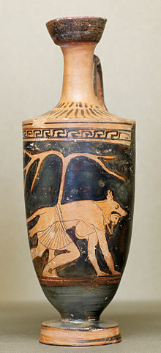
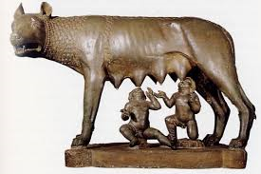
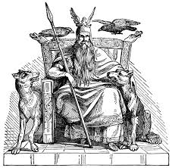
Wolf and dog
Apollo: Lykeios ‘the Wolf’’
Odin with the wolf-companions is also called ‘Wolf-killer’
Romulus and Remus raised by a she-wolf
The concept of the werewolf ‘man-wolf’

Slide 33
To become a wolf
Hittite laws, § 37:
If anyone elopes with a woman, and a group of supporters goes after them, and if two or three men are killed, there shall be no compensation: ”You have become a wolf”.
ON vargr: 1) ‘woolf’; 2) ‘an outlaw whose crimes has put him outside society, and who can be killed like the wolf’

Slide 34
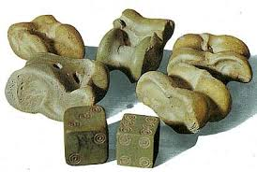
Wolf and dog
*k’wōn ‘dog’ widely attested – Gk. kýōn, Lat. canis etc.
Old suggestion: Originally *pk’wōn from *pek’u ‘cattle, sheep’
Cf. also the associations with dice in Latin, Greek and Sanskrit śva-ghnin- ‘dog-killer’; also Gk. kíndynos ‘danger’ if from kýndynos ‘dog-throw’

Slide 35
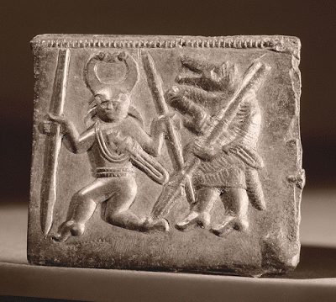
Indo-European culture as mirrorred by the lexicon
Family structure: patrilinear, patrilocal
Social hierarchy: priests/rulers, warriors, commoners
Age sets: young, mature and old men
(Latin iuventus, virtus, senectus)
Warbands: Jugendbünde, Männerbünde

Slide 36
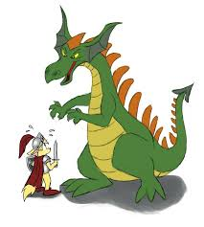
Indo-European culture as mirrored by the lexicon
Religion: Father Sky, his daughters, the Dawns, a dragon-slaying wargod, the divine twins (associated with horses)

Slide 37
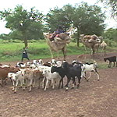
Indo-European culture as mirrored by the lexicon
Material culture: domesticated animals: horses, cattle, sheep
knowledge of wool, spinning, weaving; wagonry; dairy products
Overall picture consistent with a predominantly pastoralist society after the ”secondary products” revolution

Slide 38
What did they have and what did’nt they?
No common protoforms : Common protoforms
Goats : Sheep
Flax, linen : Wool
Pulses : Other agricultural terms (Guus Kroonen)
Horse, wheel and wagon
Dairy products (but not milk!)
They were not the first farmers – the (old) europeans already knew farming when the Indo-Europeans arrived

